Slide 1
Smells
“We must never neglect the patients own use of their symptoms.” ~ Alfred Adler

Slide 2
Mission…
“A testability smell is a symptom of a testing problem. Recognising these symptoms is the first step to establishing a more testable architecture.”

Slide 3
Objectives…
Learning Objectives:
Understand the classification of each of the smells in relation to testability
Describe the impact of the smells on delivery of projects and products
Recognise the smells as indicators of poor testability going forwards

Slide 4
Breaking Down Testability
Testable architectures have:
Decomposability
Simplicity
Controllability
Observability
Handout - Important! Ask questions

Slide 5
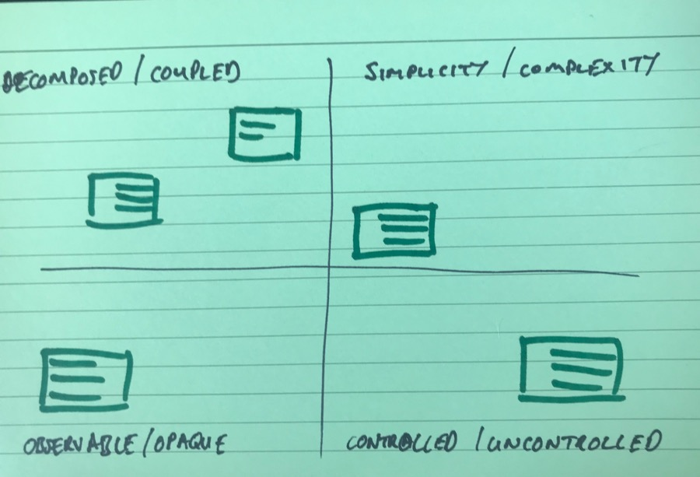
Associate
Draw a quadrant as per the above
Understand the terminology using the handouts and ask questions
Add post it notes with the smells on them to the quadrant based on the testable architecture concepts
Closer to the centre suggest multiple associations

Slide 6
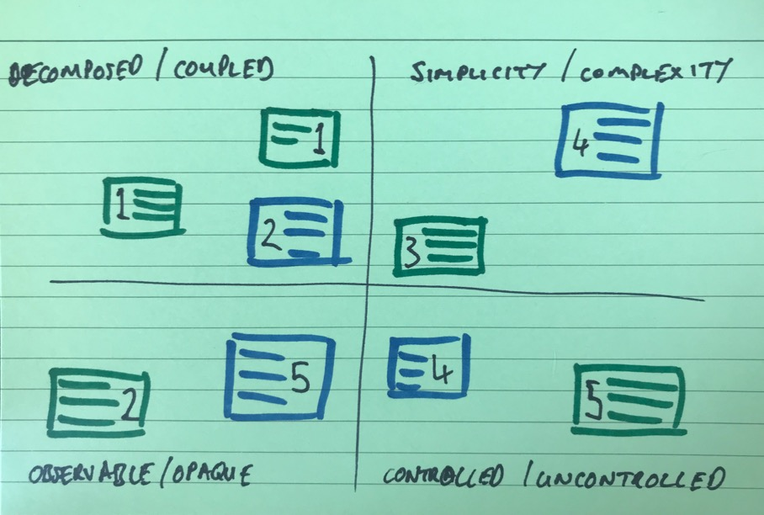
Impact
Add an impact score to each of the smells based on the following:
1 Negligible impact on time, effort and cost of delivery
2
3 Some impact on time, effort and cost of delivery
4
5 Large impact on time, effort and cost of delivery

Slide 7
Dig deep
Pick one of your high impact smells
Describe how it demonstrates low architectural testability.
Describe how it might effect your team, product and operations stakeholders

Slide 8

Summarise…
To you…
To Me…

